Slide 1


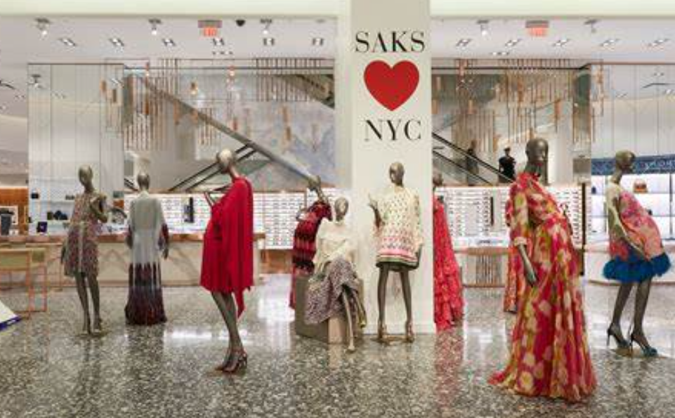


From NY 5th Avenue to Vancouver!
Crazy People for the Fashion and Technology
Great Market Opportunity
New Startup in Town
Andréa, Development and Fashion
Carlos, Development and MKT (CEO)
José, Development and quality assurance
Nicolas, Development and stores partners
Esta foto de Autor desconocido está bajo licencia CC BY

Slide 2
Business Case
Markey Opportunity
COVID accelerated the adoption of virtual services.
Styling Services are trendy and growing
Personal Styling
Virtual Styling
Wardrobe Makeover
Closet Organization
Image Consulting
Sustainable Fashion Styling.
Shopping Advise
High-profile event Styling.
Billions Market Value Industry.
Problem
The need in demand
Find the correct Advice is hard.
Solutions are focus on specific services
Few referral services and you need to jump from one place to another.
Solution
NY5th FashLink Platform
Innovative platform that delivers personalized fashion
Market Place for Fashion Advisors that can not reach a large customer base.
Market Place for Stores with a very committed customer base.

Slide 3
Business Case
For Visitors | Premium Plan: Visitors pay a monthly or yearly subscription for access to private one-on-one video or text consultations with fashion consultants. Free Plan: Visitors have limited access to general fashion videos, consultants' recommendations, and partner store products, but no private consultations.
For Advisors | Fashion consultants will be charged a small commission on each paid consultation.
For Stores | Partner clothing stores will pay a commission on sales made through the platform.
Revenue Model

